Slide 1
Rent problems in Almaty and how it affects people, in example of students
Kair Daniyal
Zhashkeev Erkanat
Idoyatov Zufar

Slide 2
Hypothesis
The more demand, the higher the price, so why is there a high demand in Almaty
In Almaty 42 universities, and about 70% students came from other cities. Only 25% of students who needed a hostel got a place.
The number of migrants from Russia to Kazakhstan has increased
There may be other factors that influence the hypothesis but do not rule it out

Slide 3
Why it is important?
Everyone needs an apartment
Costs regulation
Safety
apartment for access to education for students
In connection with recent events, many Russians come to Kazakhstan, does this factor affect changes in the price of rent in Almaty

Slide 4
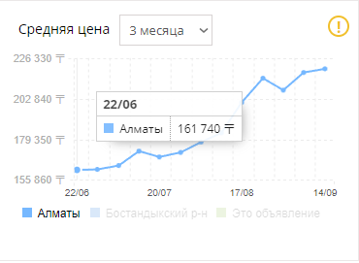
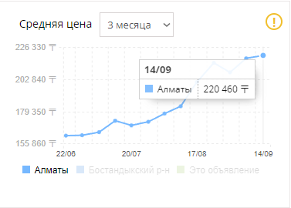
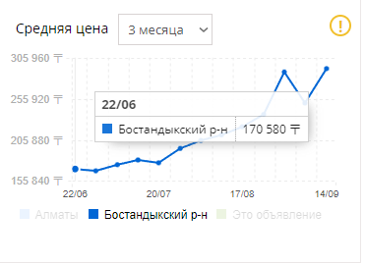
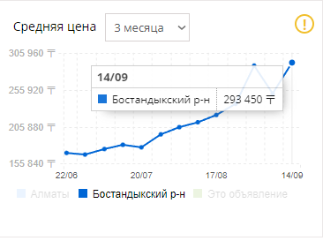
Change in rent cost for last 3 months
krisha.kz

Slide 5
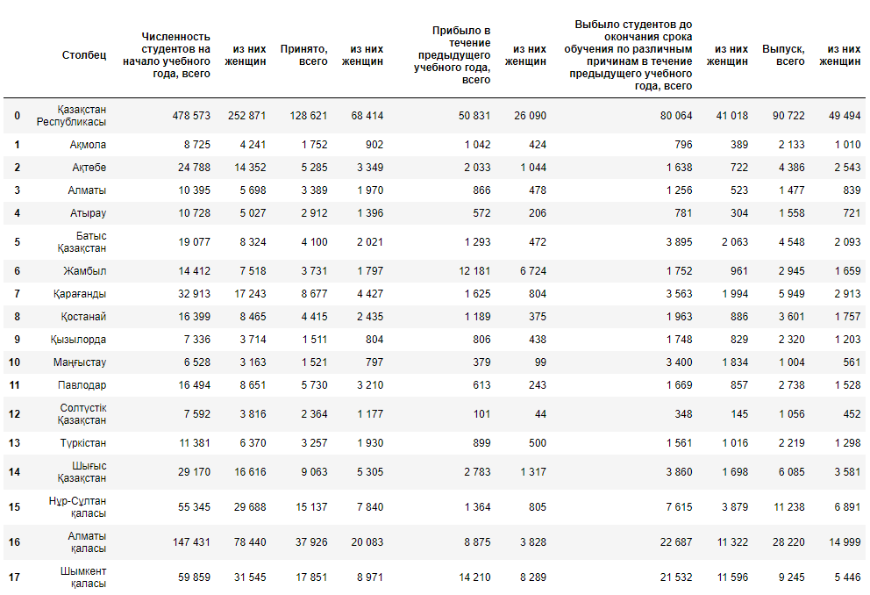
2020

Slide 6
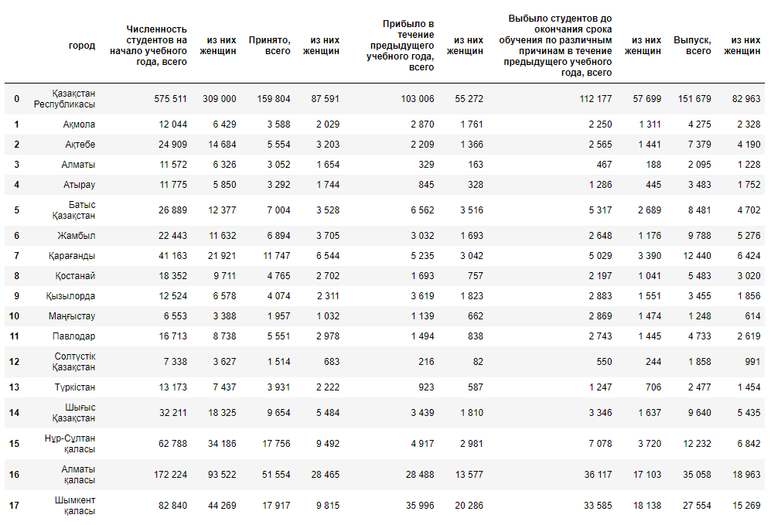
2021

Slide 7
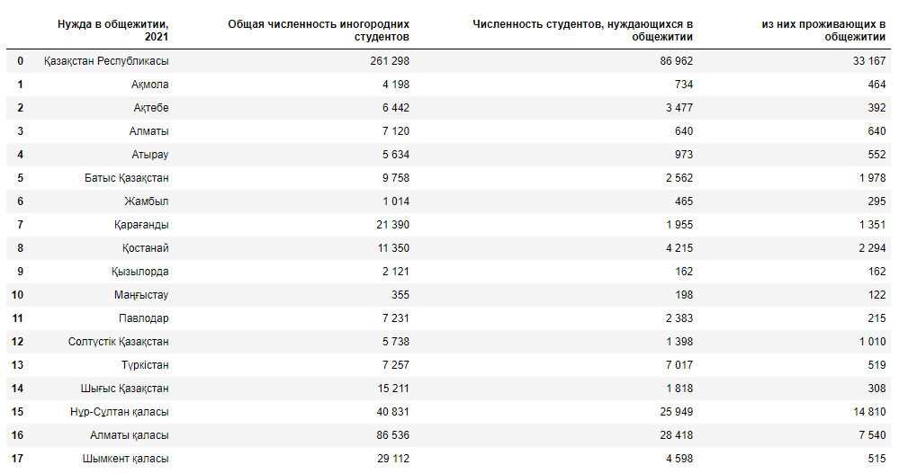
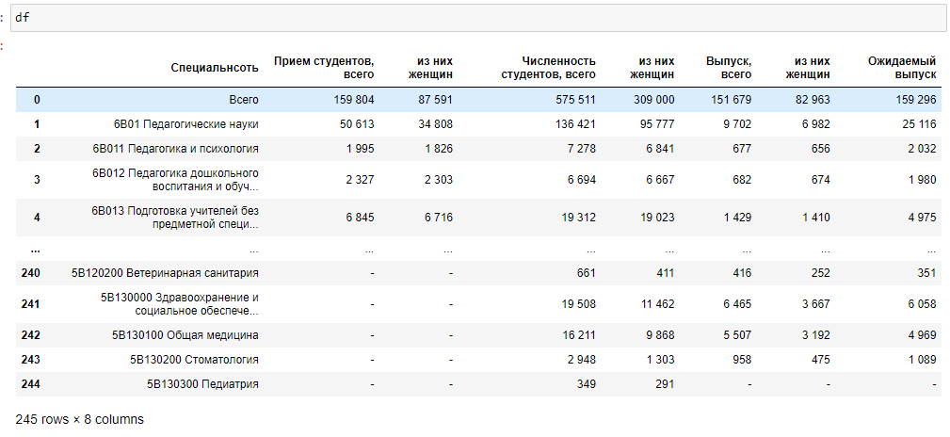
2021

